Slide 1
How To: ' A Guide to the European Settlement Scheme’
Frances Ledbury
frances.ledbury@williamsons.co.uk
01482 323697

Slide 2
What will we cover in today’s session
Brief summary of Free Movement Rights before Brexit
The transitional period
How to use the ‘EU:Exit’ App
Pre-settled status or Settled Status?
What is CSI and do I need it?

Slide 3
EU national – definition of terms
We are referring to all EEA citizens, plus citizens of Norway, Switzerland, Iceland and Lichtenstein for ease of speech

Slide 4
What will we cover in today’s session
How criminal convictions may affect you
Can you challenge a decision if you think its not right
Dependants – how to make an application for them to stay with you or join you
What next? How to apply for naturalisation if you want to

Slide 5
What were Free Movement Rights
Free Movement Rights were one of the four freedoms (Goods, People, Services and Capital) conferred to Europeans, by the original treaties signed in the forming of the European Single Market.
The old system, since 2006, was to apply for a Registration Certificate (EEA), a Residence Card (non-EEA family member, or Permanent Residence, if you had met the rules for 5 years.

Slide 6
The Transitional Period
The UK left the EU on 31 January 2020 and the transitional period ended on 31 December 2020. Certain rights then ceased;
There are rules that are tied to this date, such as when you must have started a relationship with a family member who then relies on your rights to be here as a EEA citizen (We will cover this later);
We are now in a separate period whereby EEA nationals have been given 6 months to make an application to the EUSS;
Anyone who has not applied by the end of June 2021 will become illegal in the UK.

Slide 7
Anyone who has not applied by the end of June 2021 will become illegal in the UK.
There are only very very exceptional circumstances such as illness; serious compassionate circumstances which will be overlooked.

Slide 8
Pre-settled status or Settled Status?
Settled status = Indefinite Leave to Remain
Pre-settled status = Limited leave to Remain
Settled status will be granted if the UKVI are convinced of five years of continuous residence (without gaps of more than 6 months in any 12)
Pre-settled status is for everyone else resident in the UK

Slide 9
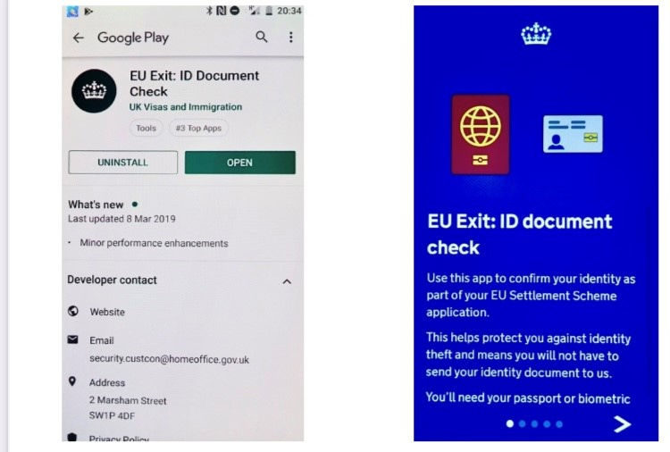
How to use the ‘EU: Exit’ App.

Slide 10
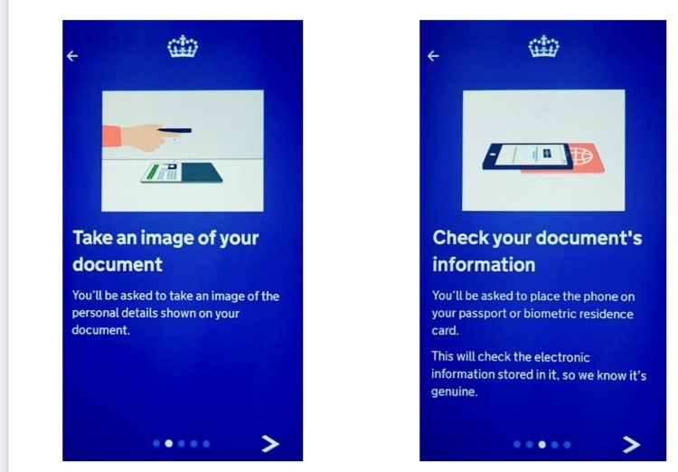
How to use the ‘EU: Exit’ App

Slide 11
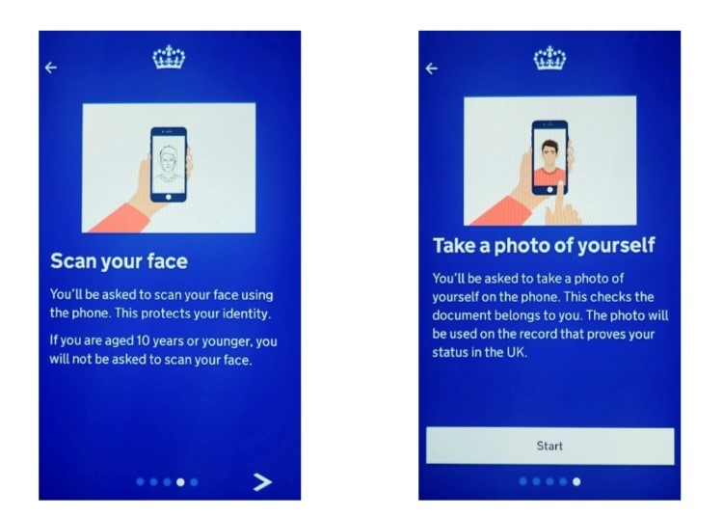
How to use the ‘EU: Exit’ App

Slide 12
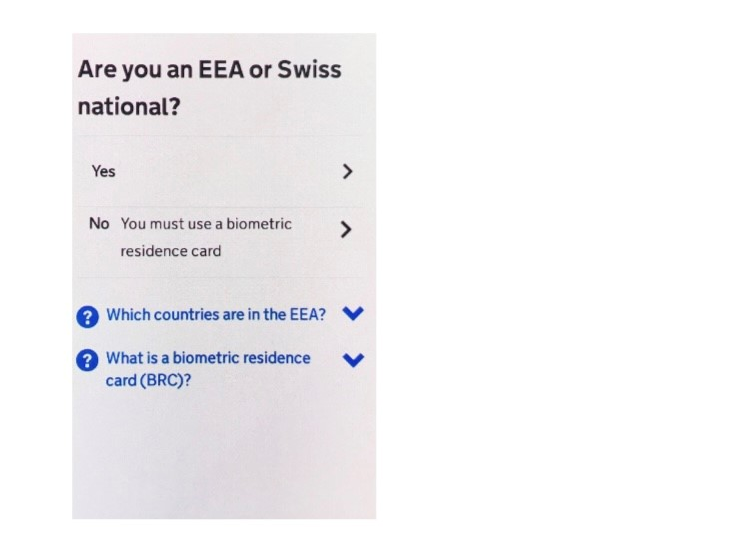
How to use the ‘EU: Exit’ App

Slide 13
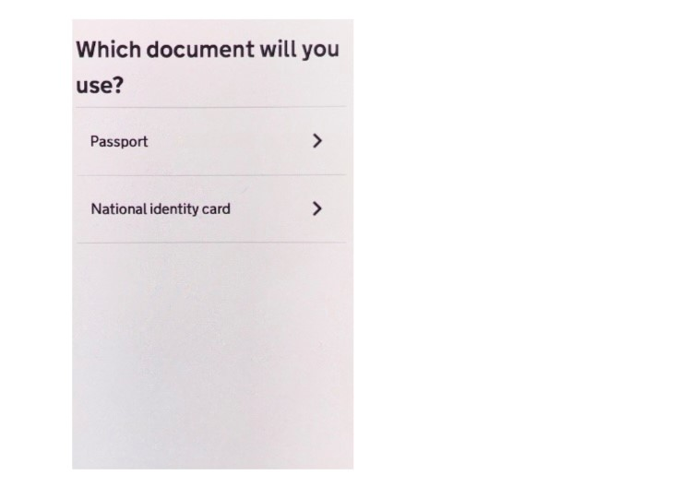
How to use the ‘EU: Exit’ App

Slide 14
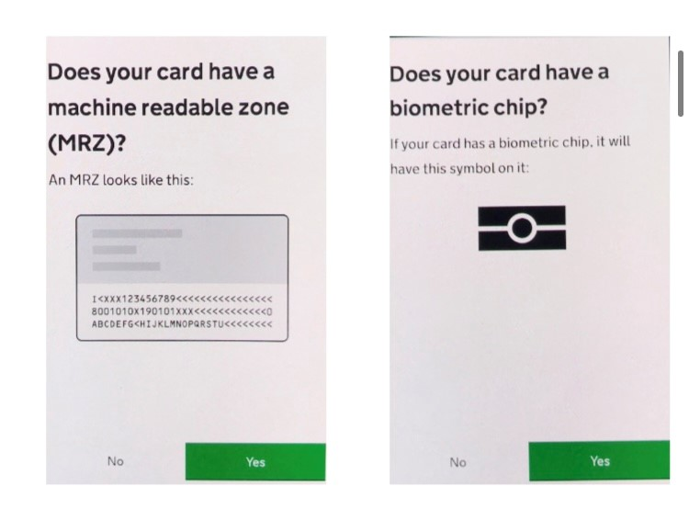
How to use the ‘EU: Exit’ App

Slide 15
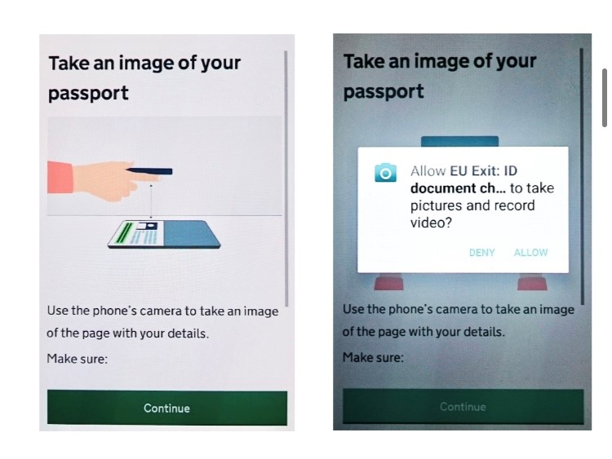
How to use the ‘EU: Exit’ App

Slide 16
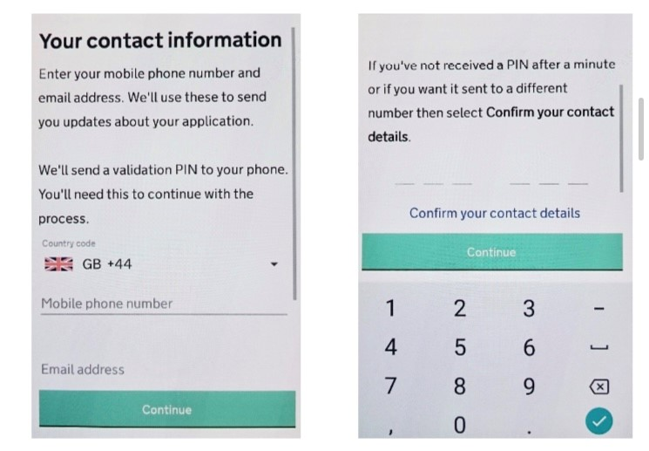
How to use the ‘EU: Exit’ App

Slide 17
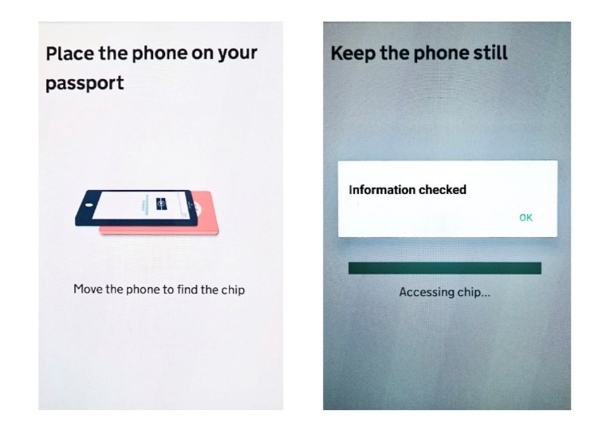
How to use the ‘EU: Exit’ App

Slide 18
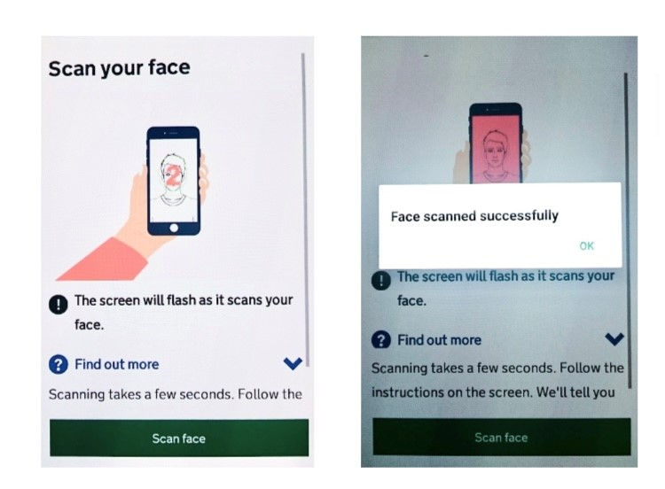
How to use the ‘EU: Exit’ App

Slide 19
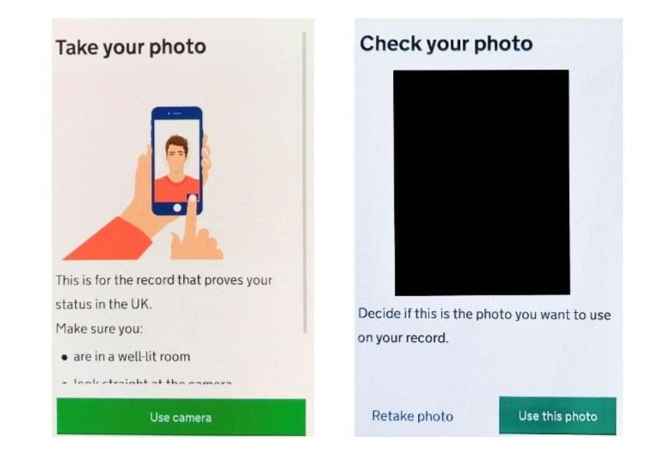
How to use the ‘EU: Exit’ App

Slide 20
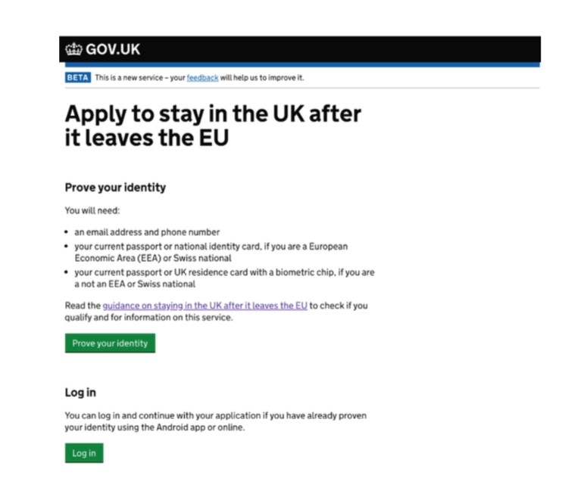
The website section of the application

Slide 21
The website section of the application
Five sections:
Identity
Application Type
Residence in the UK
Criminal Convictions
Digital photo

Slide 22
Documents to upload
10 uploads allowed
Can combine evidence
Some evidence holds more information than others (UKVI describes this as ‘Preferred’ evidence as opposed to ‘Alternative evidence’) It holds the same legal weight, but some evidence covers a longer period than others and has more detail.

Slide 23
What to do if you cannot use the app
The whole application can be done on a desktop computer; tablet; or any other device whereby you have access to the internet;
You may have to send your passport/ ID card/ BRC card into the UKVI, but they return these very promptly;
There are places (such as Hull City council libraries) whereby you can get your passport verified, currently some are not operating due to the pandemic.

Slide 24
What will I get to show my status?
EEA nationals: A letter confirming your status with a 16 Digit Reference number on it (Keep this safe!)
Non-EEA nationals: A BRC card.
If you already have a BRC card as a Non-EEA national, you still need to apply, everyone must be part of system (apart from Irish nationals and those with ILR, who it is optional for).

Slide 25
What about Children?
If your child is not British or Irish, or have some other immigration status, they need to apply. Children are not exempt!
If they were born in the UK they may not be British – we can provide advice on this please check!
If possible, do the parent’s application first. Once you have applied you will get the 16 Digit no, then you can link the application with the parent’s.

Slide 26
Non-EEA Family Members’ applications
Close family members:
Spouse/ Civil partner;
Child/Grandchild/Great Grandchild under 21;
Parent/ Grandparent/ Great Grandparent
Extended family members:
Durable partner (one you can prove you have lived with for more than 2 years/ have responsibility for a child etc);
Relative who lives with/ being cared for by sponsor;
Other dependant relative.

Slide 27
Non-EEA national Family Members– staying in the UK
Easier to apply after the main sponsor (EEA national);
You need to already have a UK immigration document issued under the EEA Regulations (2006, as amended 2015):
EEA Family Permit;
Registration Certificate;
Residence Card
Document certifying Permanent Residence;
Permanent Residence Card.
If your EEA national family member is dead/ you are divorced

Slide 28
Non-EEA/EEA national Close Family Members/ Durable partners – arriving after 31 December 2020
The relationship must have existed (and be proven to have existed) by 31 December 2020;
These family members must apply before they come to the UK, even if they are EEA family members of the sponsoring EEA national in the UK;
They would apply for an EUSS Family Permit.

Slide 29
Other exceptional applications – Seek advice!
Surinder Singh – whereby UK nationals have moved to another European country to exercise their treaty rights;
Zambrano – Primary carer for a British Citizen
Chen/ Ibrahim/ Teixeira – Primary carer for an EEA citizen
Paper forms

Slide 30
What is CSI and do I need it?
Not a requirement of EU Settlement Scheme!
So why is everyone talking about it now?
Because it matters to Citizenship (Naturalisation as a British Citizen)
What can you do if you haven’t had it during your studies?

Slide 31
How criminal convictions may affect you
EEA nationals MUST BE HONEST; whatever happens, if they find out you have used deception (lied) in an application, unfortunately your application will be refused and you may face a ban from the UK;
May face refusal and/or deportation for any offences which have led to: any prison sentence in the last 5 years; a prison sentence of over 12 months, at any time; three or more convictions in the last 3 years; or serious deception cases.

Slide 32
What to do if I get a refusal:
Most applications are being granted!
Caseworkers are taking a very positive approach, unlike other areas of UK Immigration Law;
If you are granted Pre settled instead of the Settled status you expected, seek advice, you can apply for a Administrative Review;
If you are refused – Appeal/ Judicial Review–Seek advice!

Slide 33
Do I want to Naturalise as a British Citizen?
What is ILR? Why might I want to Naturalise as well?
Difference between EU Settled status (ILR) and Permanent Residence (Not back dated, can stay outside UK > 5 years)
Expense! Currently £1349.20!
Personal decision
Citizenship for children – not Naturalisation – Born in the UK and over 10 etc.

Slide 34
Do I want to Naturalise as a British Citizen?
What requirements? (when married to a British citizen or not)
Over 18 years old;
Good character
Intention to live in the UK
Knowledge of English and Life in the UK
Meet the residence requirements (3 or 5 years)
CSI

Slide 35
What is CSI and do I need it?
CSI = Comprehensive Sickness/ Medical Insurance;
A requirement of EEA nationals in the UK exercising Free Movement Rights (not paying Tax/ National Insurance contributions), i.e. Students and Self sufficient persons;
It is now a requirement for an EEA national applying for Naturalisation, if they are relying on any period that they were in the UK as a Student/ Self Sufficient in the last 10 years, to have held CSI during that period;
Family members exempt!
There is a discretion, but it is a lot of money!
EU Commission challenge – seek advice before you apply!

Slide 36
Questions
Pre- submitted questions
Open to questions
Frances Ledbury
01482 323697
frances.ledbury@williamsons.co.uk

